Slide 1
Overview of the Virtual File System (VFS)
A comprehensive simulation of file system operations
Zongming Li & Juli Yang

Slide 2
Introduction to Virtual File System
Purpose: Simulating file system operations in a virtual environment
Technology: Python programming language
Notes:
Design a file system with a two-level structure, and implement at least the following functions: login, dir lists file directories, create, del deletes files, open opens files, close closes files, read reads files, write writes files, cd enters a subdirectory, rd deletes a subdirectory, md creates a subdirectory, and so on.

Slide 3
Introduction to Virtual File System
A comprehensive simulation of file system operations
Introduction to Virtual File System
Overview of the Virtual File System Structure
User Management
File Operations
Security and Access Control
Conclusion
Questions and Discussion

Slide 4
Overview of the Virtual File System Structure
Two-Level Directory Structure
User Accounts: Each user has a top-level directory.
Files: Under each user account, there are subdirectories for files.
Data Structure Components
Home Directory: The root for each user.
Subdirectories: Organize files under each user account.
Active Files: Stored as numbered entities (e.g., file0, file1) for easy access and modification.
Notes:
This file system uses two levels of directories, where the first level corresponds to the user account and the second level corresponds to the files under the user account. In addition, for the sake of simplicity, the file system does not take into account file sharing, file system security, pipeline files, device files, and other special features.
First of all, the data structure of the file system should be determined: home directory, subdirectories and active files. The home directory and subdirectories are stored on disk in the form of files, so that it is easy to find and modify.
Files created by the user can be numbered and stored on disk. For example: file0, file1, file2... and use the number as the physical address, registered in the directory.

Slide 5
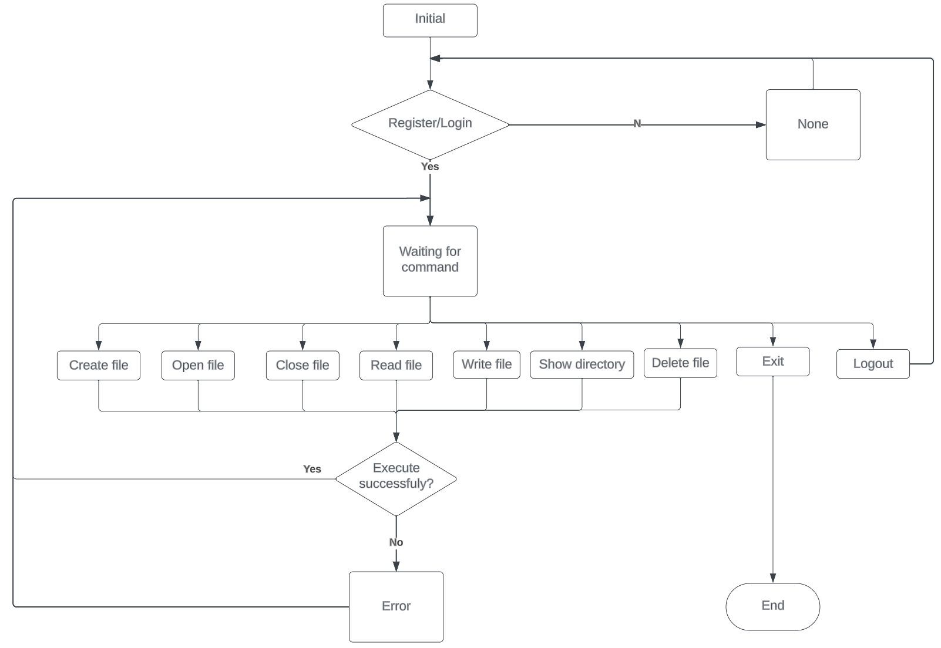
Overview of the Virtual File System Structure

Slide 6
User Management
Registration: How users can register (‘register’)
Login/Logout: User login (‘login [username] [password]’) and logout (‘logout’) mechanisms
User Data: Overview of users’ dictionary with passwords and directories

Slide 7
File Operations
Creating Files: ‘create’
Deleting Files: ‘del’
Opening and Closing Files: ‘open’ and ‘close’
Reading and Writing Files: ‘read’ and ‘write’
Listing Contents: ‘dir’
Changing Directories: ‘cd’
Creating and Deleting Directories: ‘md’ and ‘rd’
Notes:
Creating a File: When creating a new file, the system first requests the necessary external memory for the new file and assigns a directory entry to the file in FAT. The directory entry should contain the filename of the newly created file, the total capacity of the file, the currently used capacity, the file attributes, and the starting location of the file on the disk.
Deleting a file: When a file is no longer needed, it can be deleted from the file system. When deleting a file, first find the file node corresponding to the file in the file chain table of FAT, and then check whether the file is in the closed state. If all the above conditions are met, the system can delete the node from the file chain table and reclaim the disk space corresponding to the changed node.
Open files: Only files in the open state can be read, written to, or closed repeatedly and cannot be deleted.
Closed files: Only closed files can be deleted and cannot be closed repeatedly.
Write Files: Users can write data to user-defined files (on disk); the file to be written must be open, and cannot be a file of the same type as the file to be written. The file to be written must be open and cannot be a file shared by another user.
Read files: Users can read the data stored in the file; the file to be read must be open; users can either read the file they have created or read the file they have created. Users can read the files created by themselves or files shared by other users.
List File Directory: Users can only get the list of files they created or files shared by other users, and can view the list of files created by users. Users can only get the list of files they created or files shared by other users, and can view the list of files created by all users.
Create directory: Enter the name of the directory, if there exists a directory with the same name as the file, the creation fails; if there is none, check the free disk and move the file to a subdirectory. If there is no such directory, then search for a free disk, put the disk into allocated status, fill in the directory entries, and assign the address, then the subdirectory is created successfully.
Delete directory: enter the name, find out if the file or directory exists, if it is a file, it cannot be deleted; if it exists, find the starting disk block number. If it is a file, it cannot be deleted; if it is a file, find the starting disk block number and release it, modify the directory entry, and the deletion is successful.

Slide 8
Security and Access Control
Basic User Authentication: Password protection for user accounts
Access Control: User-specific directories

Slide 9
Conclusion
Summary of Features: Recap of the VFS capabilities
Potential Improvements: Areas for further development
Notes:
From the above running process, we can see that after the user logs into the system, the interface will display the basic operation of files or directories, and then according to the corresponding operation, complete the basic requirements of the system.
The result of this program is consistent with the expected result. Since the operation stage, although the results are obtained every time, the operation interface is sometimes not perfect, so we modify the program code and keep executing the program to improve it until we get a satisfactory operation interface. In this process, the basic functions required by the course design were verified, and although some operations were not perfect, they were generally realized. The most unsatisfactory feature is the dir function. It only lists the name of the directory, but does not display any other information about the directory.

Slide 10
Demonstration

